Slide 1

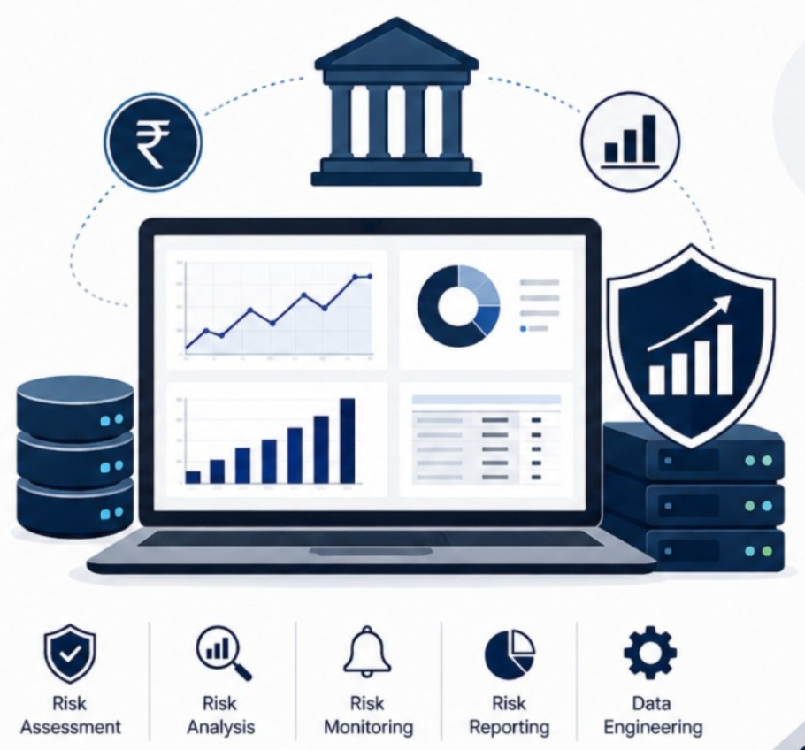
Team Members
25CS1302E - DBE & DSD
Project Review-1
Financial Risk Analytics with Polyglot Data Engineering
Group No: 16
Supervisor: [Dr. Laiphangbam Melinda]
Team Members:
[utkalika] - [251008004 ]
[Divya sri] - [2510080025]
[Ambika naidu] - [2510080033]
[Kavitha reddy] - [2510080035]

Slide 2
PROJECT REVIEW-1
Problem Statement
What is the problem?
Why does it matter?
Who faces it?
Banks handle high-volume customer, account, and transaction data that is difficult to analyze across separate systems.
Delayed risk detection can lead to fraud exposure, poor compliance visibility, and weak financial decisions.
Customers, bank admins, finance teams, and risk analysts who need trusted data and fast financial reports.
Core Problem
A secure analytics platform is needed to unify relational and NoSQL financial data, process transactions, and surface risk insights quickly.
02

Slide 3
SOCIETAL / INDUSTRY NEED
Need for the Project
1
Reliable financial decisions
Banks need clean customer, account, and transaction data to detect exposure and support risk review.
2
Secure customer service
Customers benefit from accurate accounts, safer transaction handling, and timely financial visibility.
Impact
Operational efficiency
Risk alerts
Safer banking
Fast reports
3
Bank admins can reduce manual checks through authenticated APIs, automated processing, and reports.
4
Industry-ready architecture
Polyglot storage and distributed backend services mirror modern financial technology systems.
03

Slide 4
PROJECT REVIEW-1
Project Objectives
Manage customers and accounts
Process transactions reliably
Enable JWT-secured REST APIs
Create secure customer profiles, account records, balances, and relationship mapping.
Validate deposits, withdrawals, transfers, transaction logs, and account updates.
Protect customer, bank admin, transaction, and report endpoints with token-based access.
Deliver financial analytics
Support deployment and testing
Analyze transaction patterns, financial risk signals, summaries, and performance reports.
Package scalable backend services with documentation, test cases, and deployment readiness.
04

Slide 5
PROJECT REVIEW-1
Proposed Solution / Methodology
Solution Approach
Main Modules
Build a secure financial analytics platform that manages customers and accounts, processes transactions, stores data in PostgreSQL + MongoDB, and exposes JWT-secured REST APIs.
Customer & Account Management
Transaction Processing
Financial Analytics
REST APIs with JWT
Deployment, Testing & Docs
Customers
Validation
Transactions
PostgreSQL + MongoDB
Financial Reports
05

Slide 6
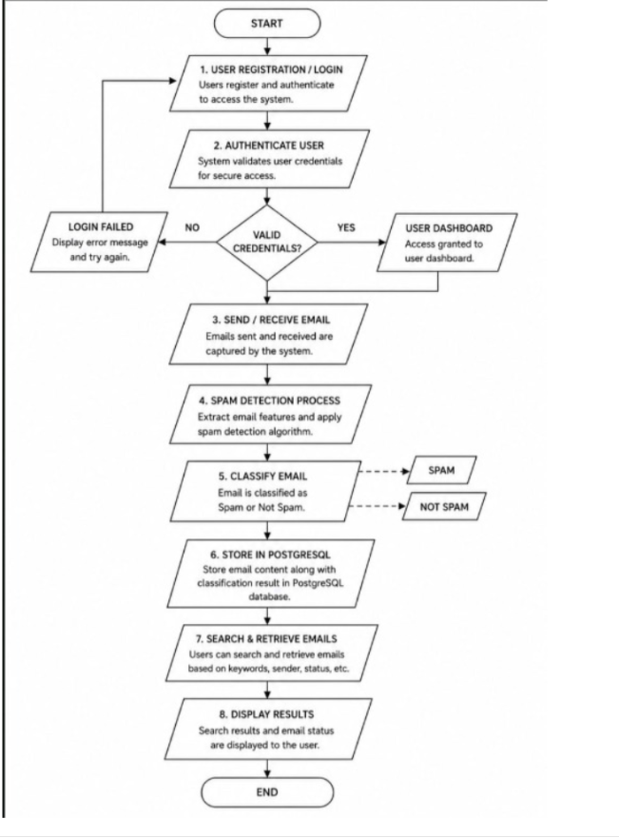
PROJECT REVIEW-1
Flow Chart
05

Slide 7
PROJECT REVIEW-1
Feasibility Analysis
Hardware requirement
Software requirement
Storage & APIs
Laptop- 16GB RAM,mult-core CPU.
Windows11 OS
Cloud/server environment if deployed
Language: Java / Python 3.11/ Node.js
IDE: VS Code / IntelliJ
Framework: Spring Boot / Fast API ,Express
PostgreSQL + MongoDB
REST APIs with JWT
Testing: Postman (v11.0), Swagger (Open Api 3.1)
Dataset Requirement
Synthetic or public financial transaction dataset with customer, account, transaction, and risk/reporting fields.
06

Slide 8
PROJECT REVIEW-1
Novelty & Future Scope
What makes it unique?
Compared to existing solutions
Key innovation
Combines JWT authentication, transaction processing, financial analytics, and deployment-ready services.
Uses polyglot engineering: PostgreSQL for banking records and MongoDB for flexible analytics data.
Traditional systems focus on storage; this adds secure APIs, analytics, and distributed backend design.
Future Scope
Fraud detection models, live risk scoring, role-wise dashboards, cloud scaling, and regulatory reporting.
07

Slide 9
Thankyou
07

